Slide 1



Arts Council England Environmental Reporting 2019/20
Will Price, Julie’s Bicycle
Brianna Francis, Julie’s Bicycle

Slide 2

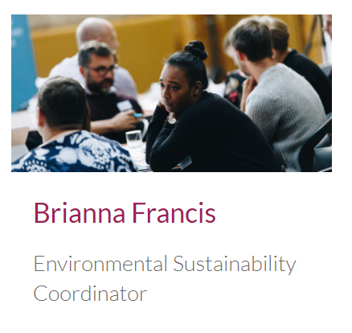
Welcome!
Notes:
LL - welcome and purpose of the session
An informal webinar for Relationship Managers to discuss any issues or questions regarding environmental reporting for year 2019/20.
Update on the programme more broadly

Slide 3
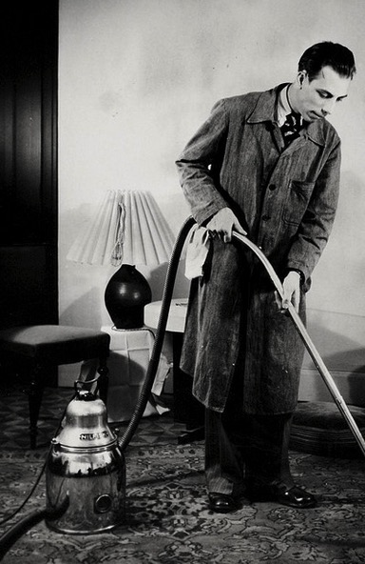

Housekeeping
Raising hands
Asking questions
Sharing presentations
Recording content
Notes:
You should be able to see a hand sign on your screen; if you can please click it now that should give us an indication that you can hear me and we are ready to begin… Regarding questions, my colleague Farah will be monitoring your questions as they come in – use the question box to submit your questions during the Q&A session at the end of this webinar.

Slide 4


AGENDA
Introduction to Julie’s Bicycle
The Arts Council England Environmental Programme
Covid-19 Update
NPO environmental reporting for 2019/20
Introduction to the Creative Green Tools
Q&A

Slide 5

Julie’s Bicycle is a charity which supports the creative community to act on climate change and environmental sustainability
- as a community uniquely placed to transform the conversation around climate change and translate it into action
Photo, Suzanna Zhang
Notes:
Julie’s Bicycle is a charity with 11 years’ experience supporting the creative and cultural sector to take direct action on climate change and environmental sustainability.

Slide 6

Consultancy
Environmental sustainability
Policy
Advocacy
Research
Training
Tools & Resources
Convening
Inspiration
Arts &
creative industries
Notes:
Working at this intersection of Environmental Sustainability and Arts & Creative Industries JB offers free events, expert resources, carbon tracking tools, training, consultancy, and certification to equip organisations with the knowledge and confidence to speak out and together on this issue. You can find out more about our work on our website.

Slide 7


ACE Environmental Programme 2018-22
Notes:
One big project we work on that spans all of these areas is our partnership with Arts Council England - this webinar is a specific output of this programme. Julie’s Bicycle has been partnered with Arts Council England to deliver their Environmental Porgramme since 2012. Helping funded organisations report on annual environmental impacts, supporting arts organisations to take action. The programme includes free resources, briefings, help-desk support, events and webinars all aimed at increasing literacy in the sector. You can find more information in our latest Annual Report, with case studies from all types and sizes of organisations. You can download it from Julie’s Bicycle.com or Arts Council website.

Slide 8


Slide 9


Slide 10


Slide 11
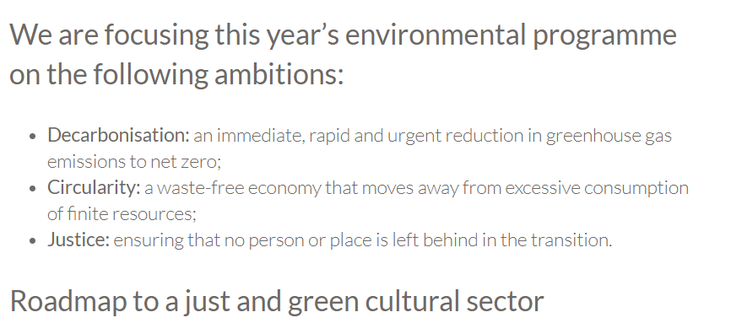

Slide 12

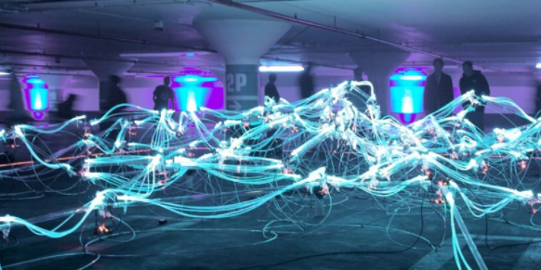
Webinars and resources Digital creativity webinar (Tues 25th) Digital briefing (month end) Travel and offsetting briefing (Sept+Oct)
Other programme updates
Season for Change Toolkit live Season for Change is a nationwide programme of artistic and cultural events that celebrate the environment and inspire urgent climate action
In the Season for Change Toolkit, you’ll find top tips, case studies and resources to help you get started.

Slide 13
Covid-19 Update
In response to the Covid-19 situation the original deadlines for Arts Council England environmental reporting were lifted back in May.
We are now reinstating a reporting timeframe and are encouraging organisations where possible to complete their reporting by the 30th October.
The Julie’s Bicycle team will be working remotely and have a new support phone-line open Tuesday-Thursday for reporting queries. In the meantime, you can still contact us via email.
Notes:
You should be able to see a hand sign on your screen; if you can please click it now that should give us an indication that you can hear me and we are ready to begin… Regarding questions, my colleague Farah will be monitoring your questions as they come in – use the question box to submit your questions during the Q&A session at the end of this webinar.

Slide 14
NPO Environmental Reporting
Upload an up-to-date environmental policy and action plan to the Creative Green Tools.
Enter environmental data (outlined in funding agreement) into the Creative Green Tools covering April 2019 – March 2020.
Organisations are encouraged to report before 30th October 2020

Slide 15
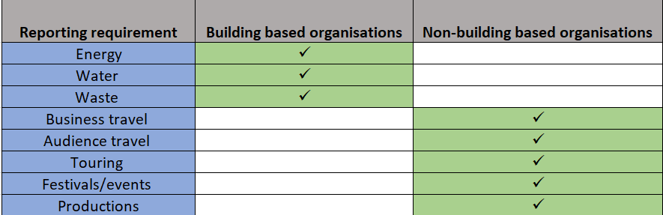
What do I need to report on?
Your reporting requirements should have been agreed with your Relationship Manager and can be found in the 2018-22 Funding Agreement Conditions.
These requirements are tailored to each organisation.
Notes:
On the left hand side of this table you can see a list of the Arts Council reporting requirements for NPOs which you may have seen already through your RM.
NPOs are required to report on the impacts in this that are most relevant to them. Each NPO therefore will be reporting on different impacts reflecting the varied nature of organisation in the portfolio which range in size, artform and resources. I will explain in moment what kind of data is associated with these categories.
Your should already have had a conversation with your RM about which of these areas you will be reporting on which should be documented in your funding documents.
If you are unsure the table shows one way of thinking about which impacts are most relevant to you use is thinking about how you operate as an organisation. For example, as shown in the table, if you are building based organisation such as a theatre, museum or library, or if you operate out of a main office building then impacts that would be relevant you would be those connected to your building e.g. energy use, water consumption, waste produced by the building.
If you are a non-building based organisation, or you operate in a building over which you have limited control such as a serviced office, then some areas that you could look are areas such as business travel, any touring work you might do, or events.
An important think to make clear is that there is not a set number of areas that an NPO must report on from this list. The idea of the requirements are that they encourage organisations to think about their activities and where their biggest impacts lie. For many organisation this will be a learning process and organisation with multiple venues, running events and tours all simulatenously shouldn’t be put off thining that they need tomionitor every single piece of actitivty they do. For example, a touring organisation might choose initially to report on only their office building and one of their larger tours. Starting small and building up your reporting is usually a good approach.
If you are unclear contact us – details at the end of the webinar.

Slide 16
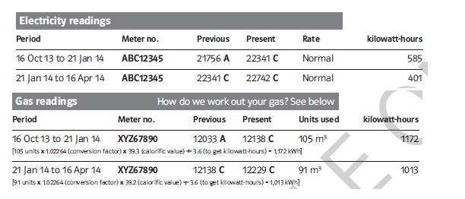
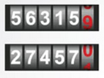
How do I collect energy data?
Energy consumption is measured in kWh for both electricity and gas.
You can collect kWh figures for electricity gas in your basic energy bills or through manual meter readings.
kWh
kWh
kWh
Notes:
There are two main ways to collect energy and water data through meter readings and invoices
The first one is through meter readings. How data is presented varies a lot from one meter reading to another. Some meter readings give energy data in kwh for electricity and gas and some meter readings show gas information in m3. If that former one is your case, you need to get in contact with us as we can convert m3 to kwh. Water. It normally shows the information in m3.
The second one is invoices.

Slide 17
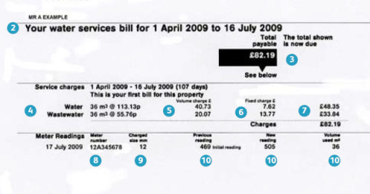
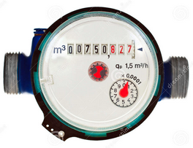
How do I collect water data?
Water consumption is measured in m3.
You can collect m3 figures for water and wastewater in your basic water bills or through manual meter readings.
m3
m3
Notes:
There are two main ways to collect energy and water data through meter readings and invoices
The first one is through meter readings. How data is presented varies a lot from one meter reading to another. Some meter readings give energy data in kwh for electricity and gas and some meter readings show gas information in m3. If that former one is your case, you need to get in contact with us as we can convert m3 to kwh. Water. It normally shows the information in m3.
The second one is invoices.

Slide 18

How do I collect waste data?
1. Tonnes per waste stream
Tonnage can be found on the bills from your waste contractor for each waste stream e.g. landfill, energy, recycling
Or
2. Estimated figures
Record the number of bin collections you have monthly for each waste stream: e.g. one 500L bin collected twice a week going to landfill

Slide 19

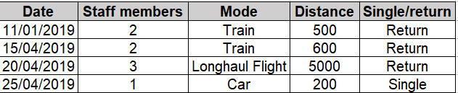
How do I collect travel data?
For business travel, you will need to record:
Miles travelled
No. of people travelling
Vehicle type
Example tracker:

Slide 20
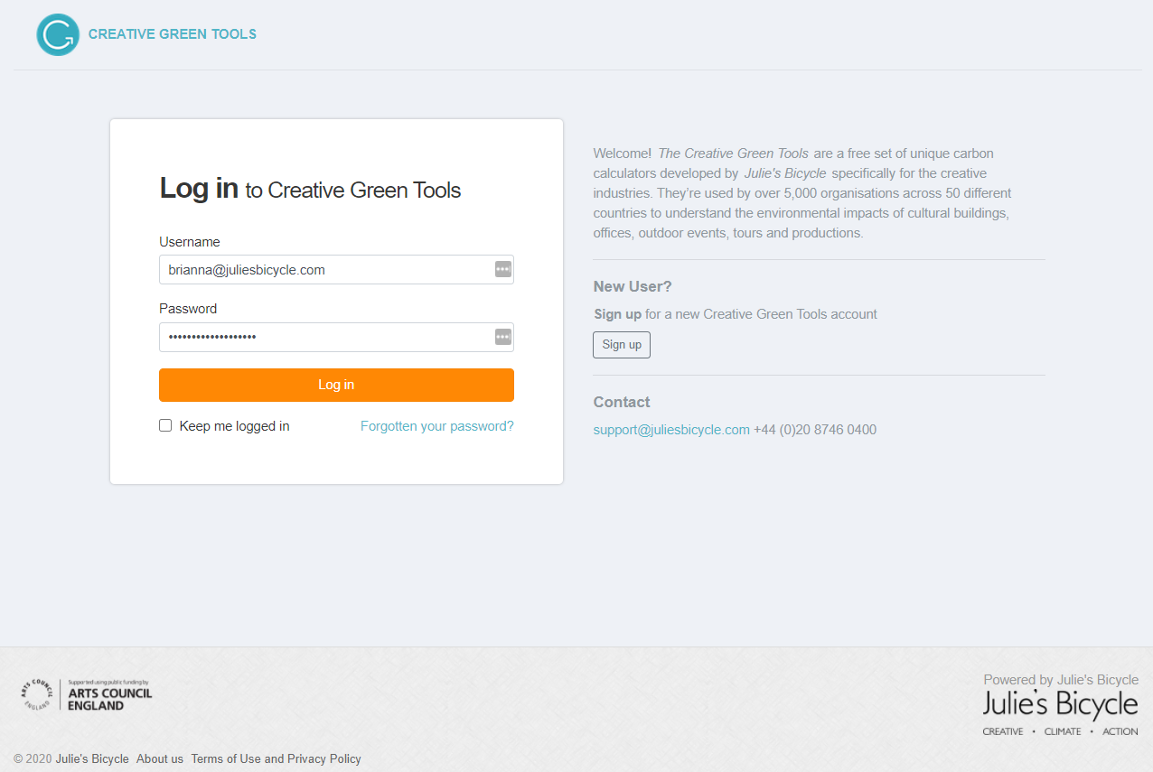
Landing Page
Notes:
New design! Accounts are created as for each organisation not individually. If you think your organisation already has an account and you would like to access this then contact our support email and we will add you to the account. If you a creating an account for the first time as an NPO you will need to select the financial year button.

Slide 21
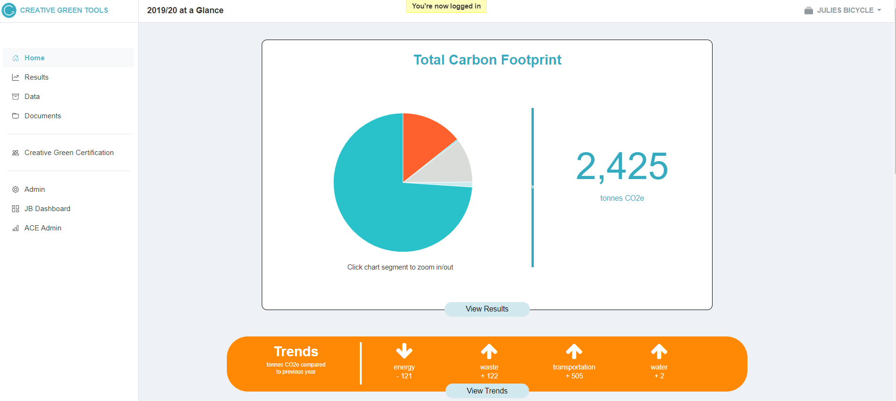
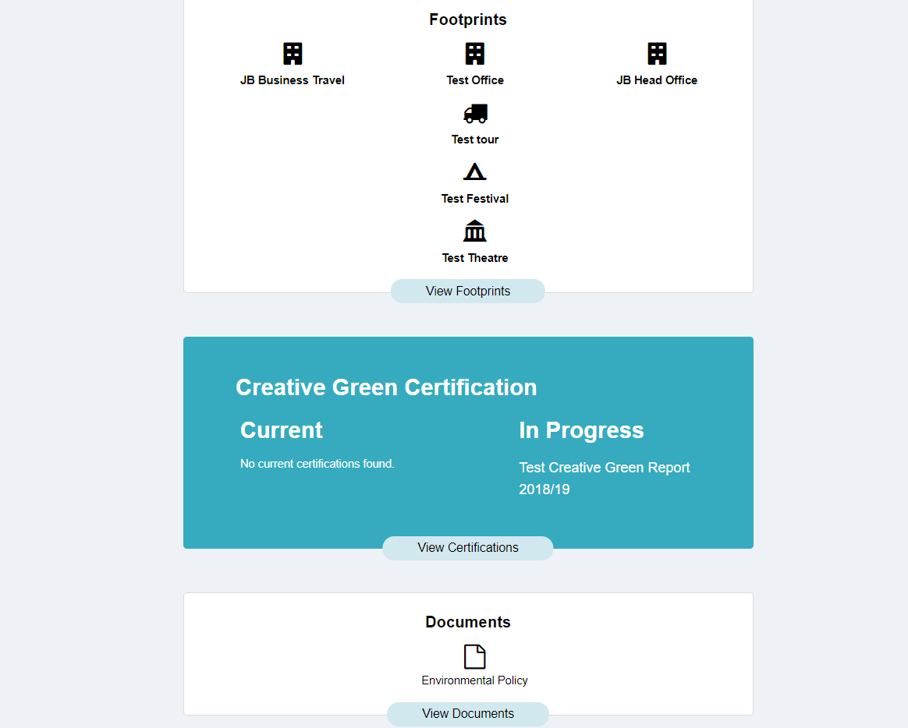
Home Page
Notes:
View total carbon footprint, any trends, footprints for individual projects/buildings, if you’re in the CG cert and any documents you have uploaded

Slide 22
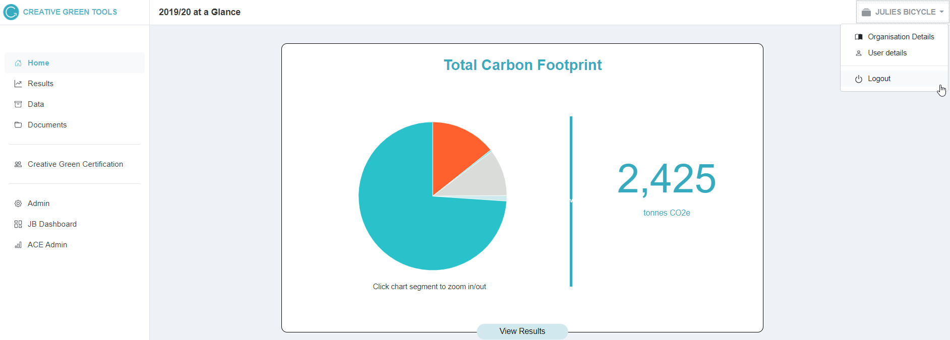
Home Page
Notes:
Navigation has moved to the side – the home page will show the most recent year that you’ve submitted data

Slide 23
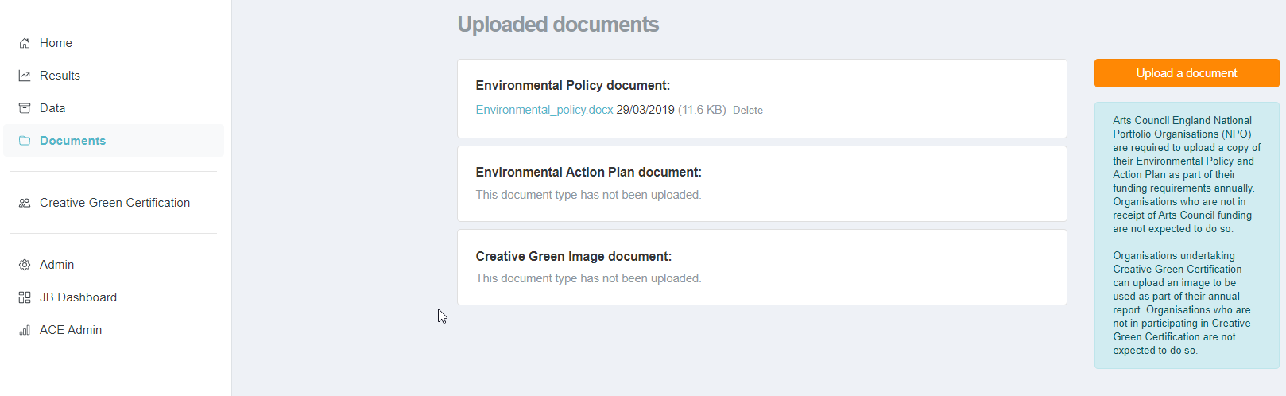
Documents page
Home Page
Notes:
Uploading documents: need envi policy and action plan – action plan should be different each year as it’s a working document.

Slide 24
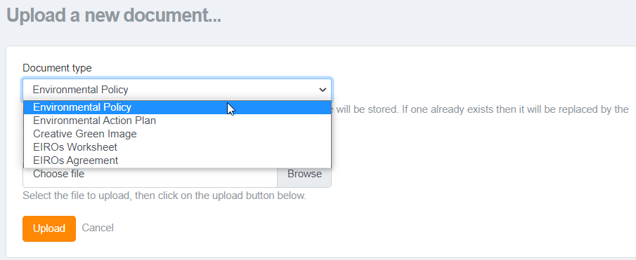
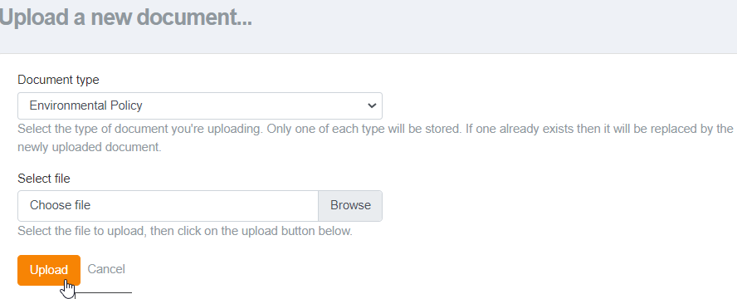
Documents page
Home Page
Notes:
Upload each document – one at a time. Don’t forget to actually upload the document before clicking back.

Slide 25
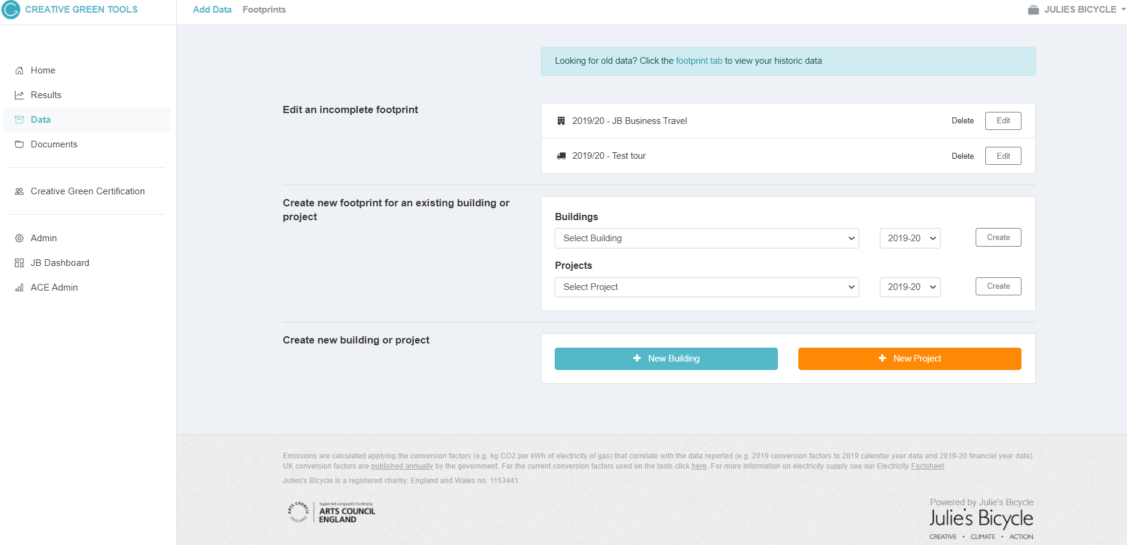
+ Data page
Notes:
We’ve made the page a lot easier to navigate. This is where you will add data and create your footprints for either your building or projects. You can also navigate to previous footprints from this page.

Slide 26
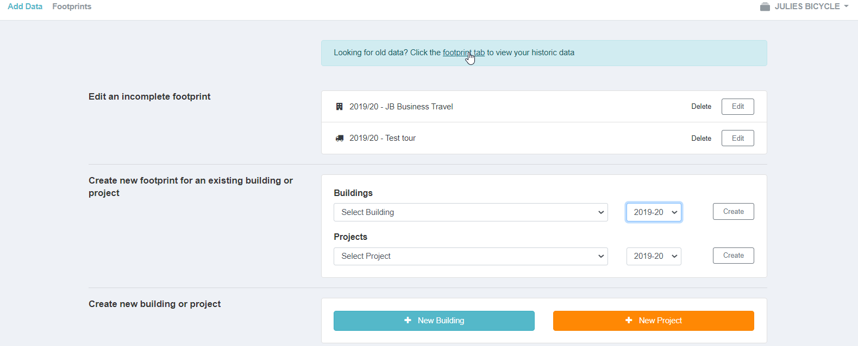
+ Data Page
Notes:
This the page where you will come to add data to your account or to edit old data.
As an organisation you can create Buildings or Projects to report data on. Buildings refer to any office, venues or cultural buildings you organisation looks after. Projects refer to any of your additional activity including Tours, Productions, Events or Festivals
Most organisations will add to an existing building or an ongoing/reoccurring project

Slide 27
+ Data Page
Notes:
From here you’ll be able to edit an incomplete footprint. When creating a footprint, you don’t need to complete it in one go. If you submit a footprint, you will be able to view it under footprints. As an organisation you can create Buildings or Projects to report data on. Buildings refer to any office, venues or cultural buildings you organisation looks after. Projects refer to any of your additional activity including Tours, Productions, Events or Festivals
Most organisations will add to an existing building or an ongoing/reoccurring project

Slide 28
+ Data Page
Add data to a Building/Project that has already been created
Notes:
This the page where you will come to add data to your account or to edit old data.
As an organisation you can create Buildings or Projects to report data on. Buildings refer to any office, venues or cultural buildings you organisation looks after. Projects refer to any of your additional activity including Tours, Productions, Events or Festivals
Most organisations will add to an existing building or an ongoing/reoccurring project

Slide 29
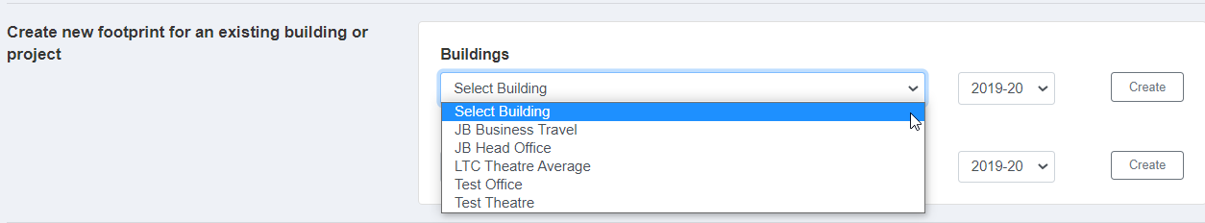
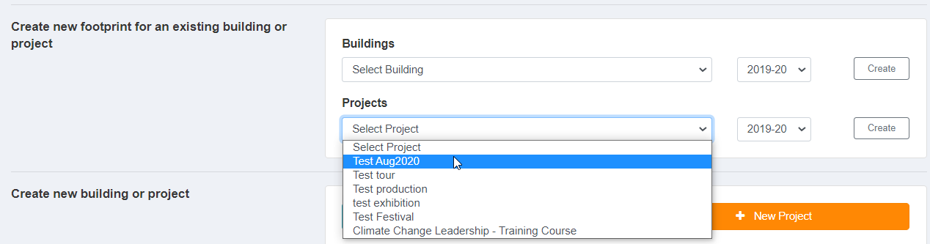
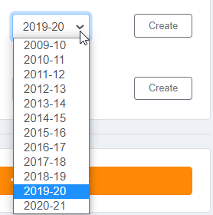
+ Data Page
Add data to a Building/Project that has already been created
Notes:
As an organisation you can create Buildings or Projects to report data on. Buildings refer to any office, venues or cultural buildings your organisation looks after. Projects refer to any of your additional activity including Tours, Productions, Events or Festivals
Most organisations will add to an existing building or an ongoing/reoccurring project

Slide 30
+ Data Page
Create a new Building/Project
Notes:
This the page where you will come to add data to your account or to edit old data.
As an organisation you can create Buildings or Projects to report data on. Buildings refer to any office, venues or cultural buildings you organisation looks after. Projects refer to any of your additional activity including Tours, Productions, Events or Festivals
Most organisations will add to an existing building or an ongoing/reoccurring project

Slide 31
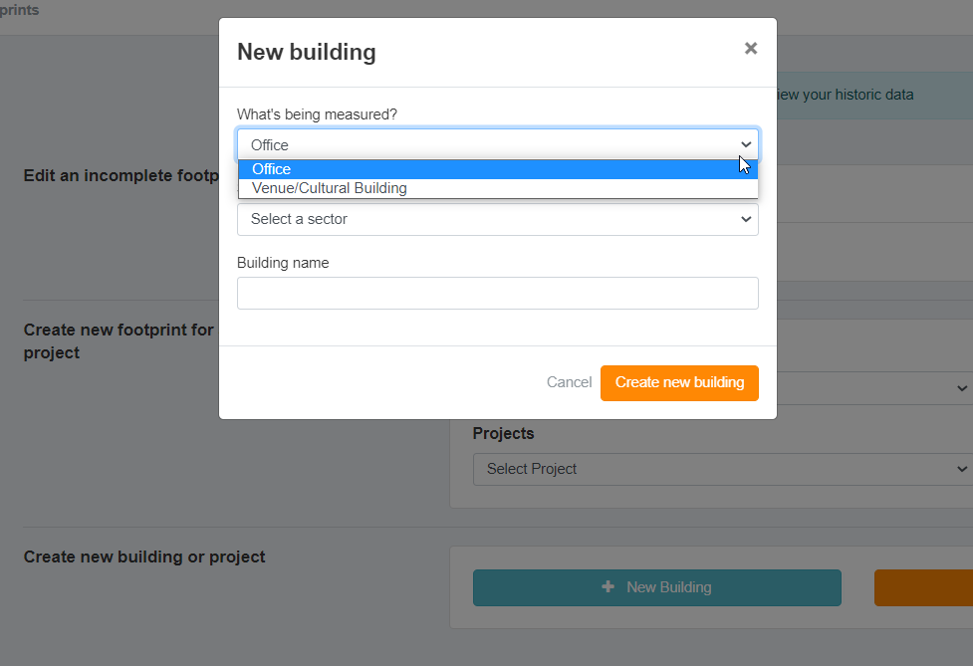
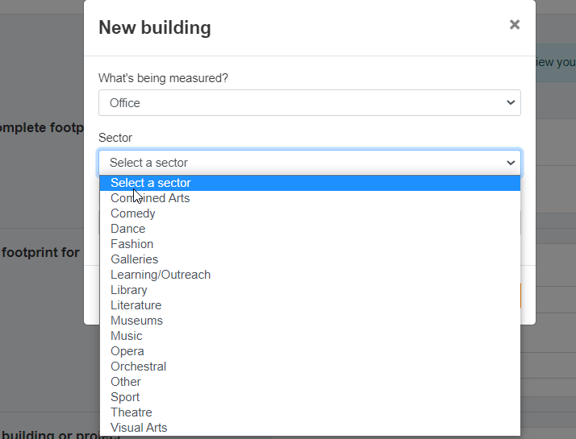
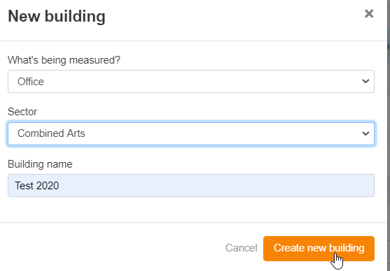
+ Data Page
Create a new Building/Project
Notes:
This the page where you will come to add data to your account or to edit old data.
As an organisation you can create Buildings or Projects to report data on. Buildings refer to any office, venues or cultural buildings you organisation looks after. Projects refer to any of your additional activity including Tours, Productions, Events or Festivals
Most organisations will add to an existing building or an ongoing/reoccurring project

Slide 32
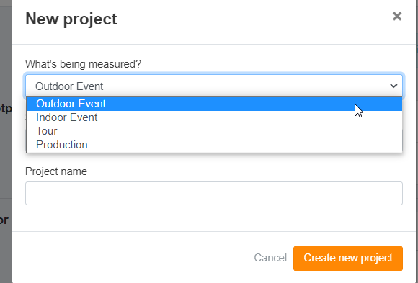
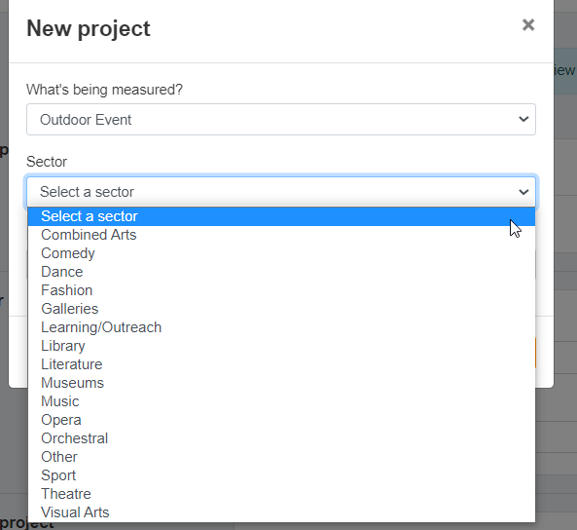
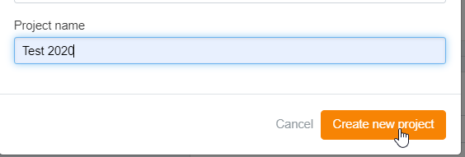
+ Data Page
Create a new Building/Project

Slide 33
+ Data Page
Notes:
This the page where you will come to add data to your account or to edit old data.
As an organisation you can create Buildings or Projects to report data on. Buildings refer to any office, venues or cultural buildings you organisation looks after. Projects refer to any of your additional activity including Tours, Productions, Events or Festivals
Most organisations will add to an existing building or an ongoing/reoccurring project

Slide 34
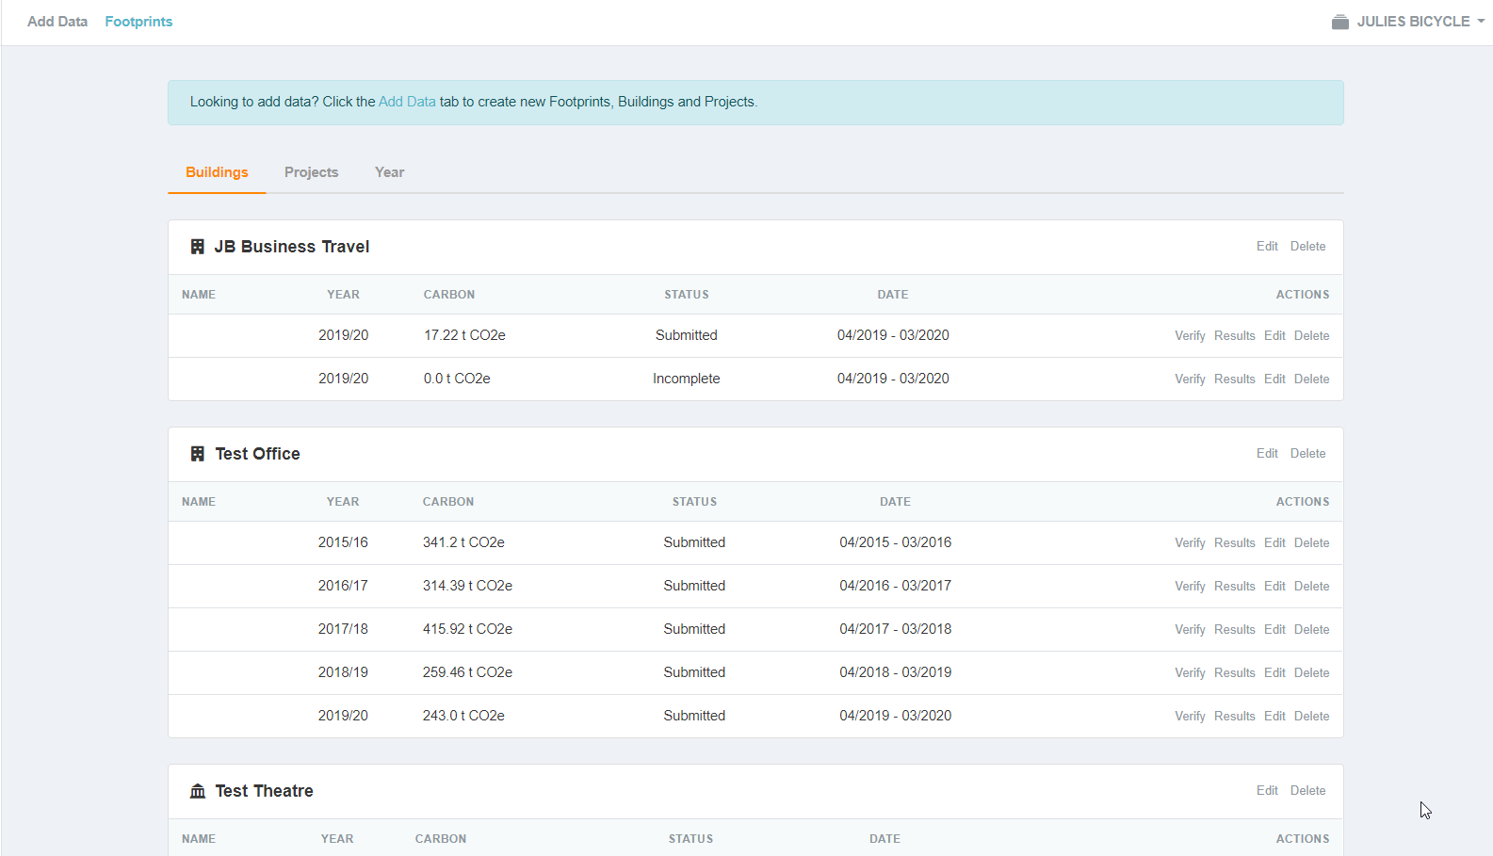
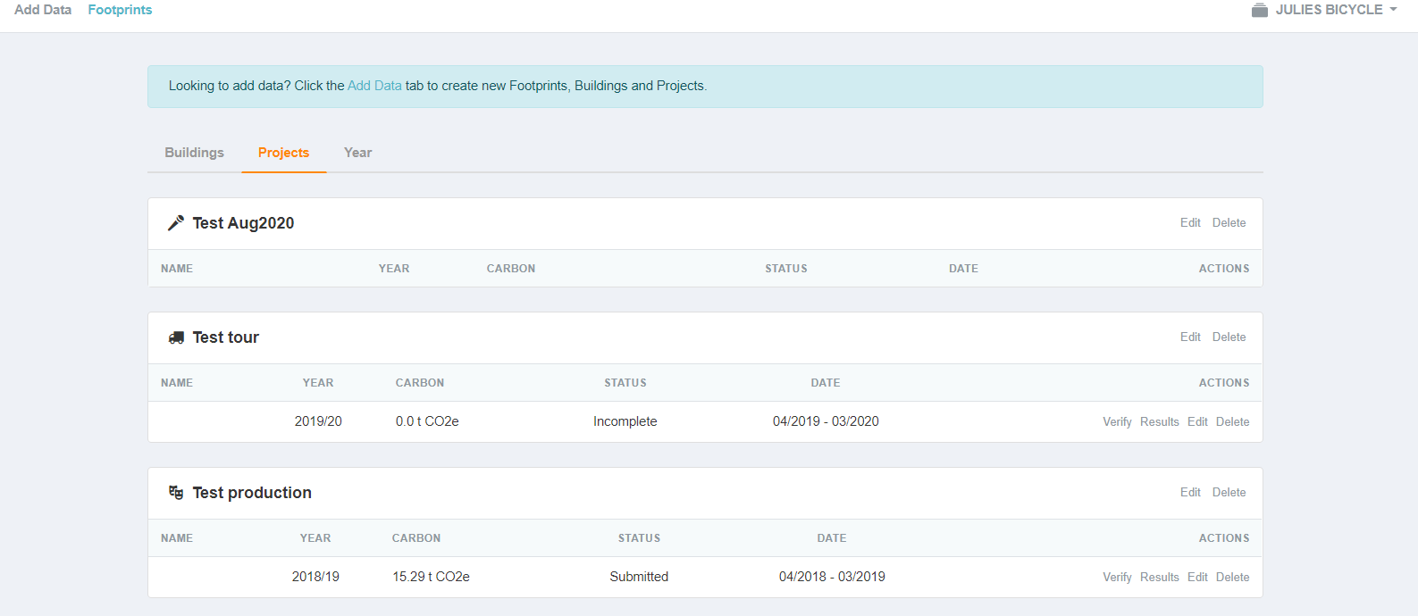
Footprint Page
Select ‘Footprints’ to view historic data
Notes:
View foot prints by building, projects, year. Once your in here you can see the different areas that you can report such as energy, water and waste

Slide 35
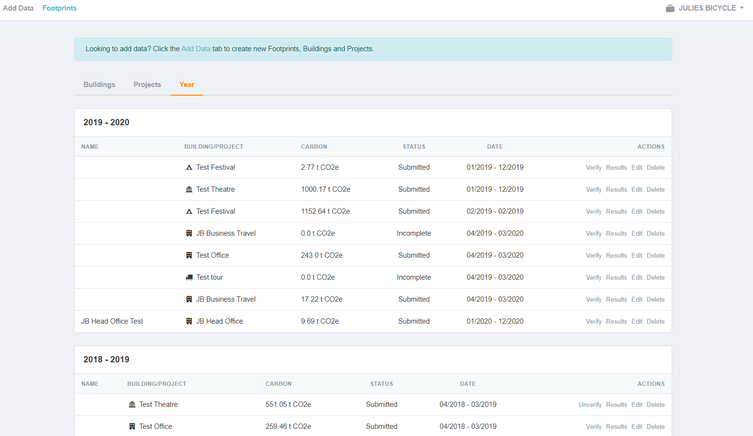
Footprint Page
Select ‘Footprints’ to view historic data

Slide 36
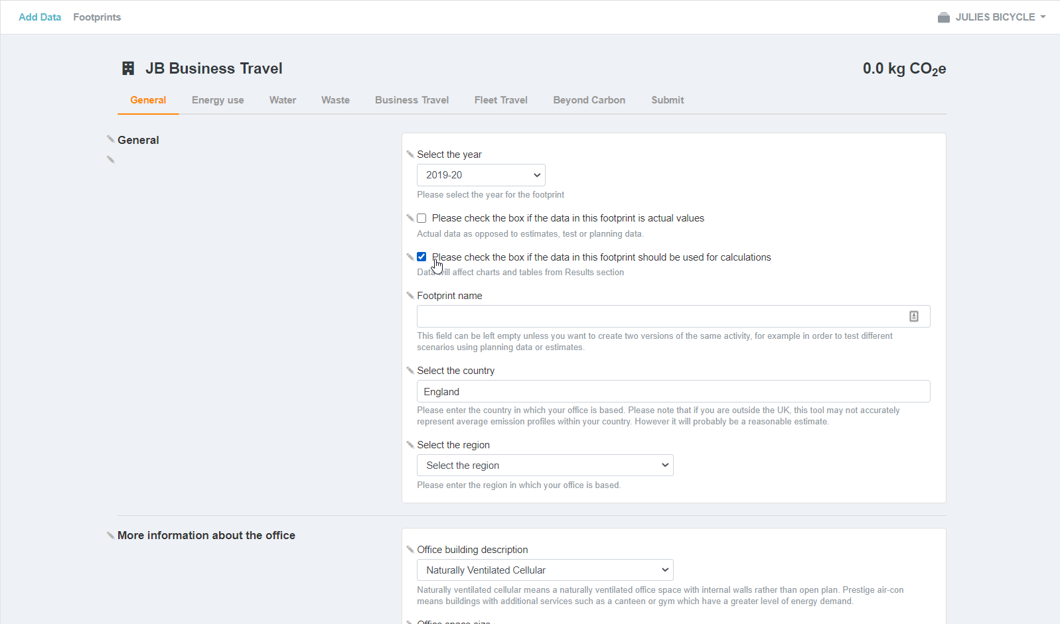
Footprints Page: General

Slide 37
Footprints Page: General
Select the previous financial year
Notes:
Select the previous financial year = April 2019-march 2020
Tick box so data is used for calculations to generate a footprint

Slide 38
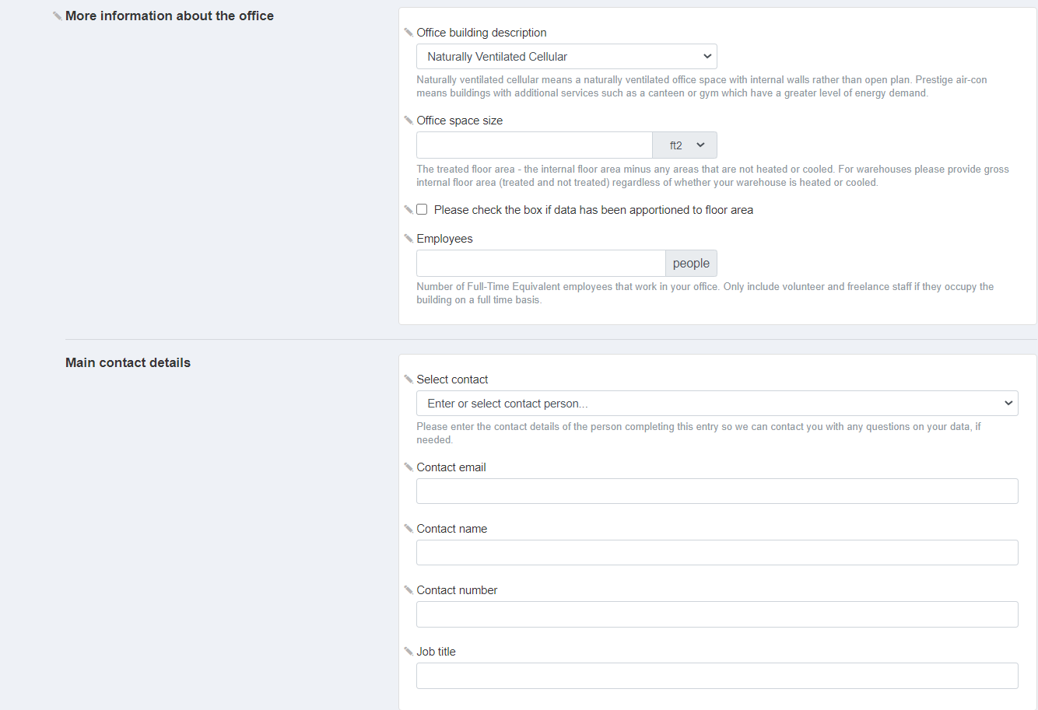
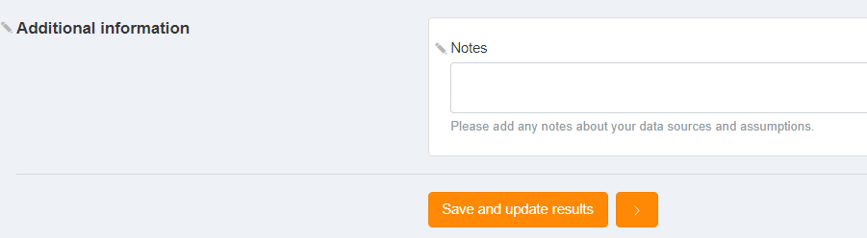
Footprints Page: General

Slide 39
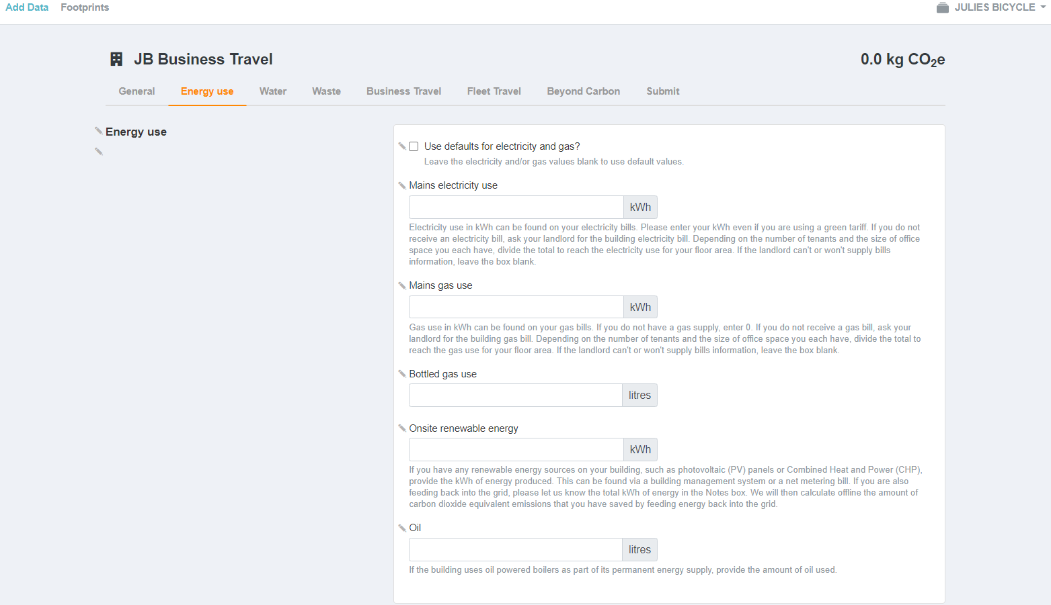
Footprints Page: Energy
Electricity and Gas consumption (kWh) can be found in your bills
Notes:
Includes electricity supplier and energy use notes like tariff details. Always SAVE!

Slide 40
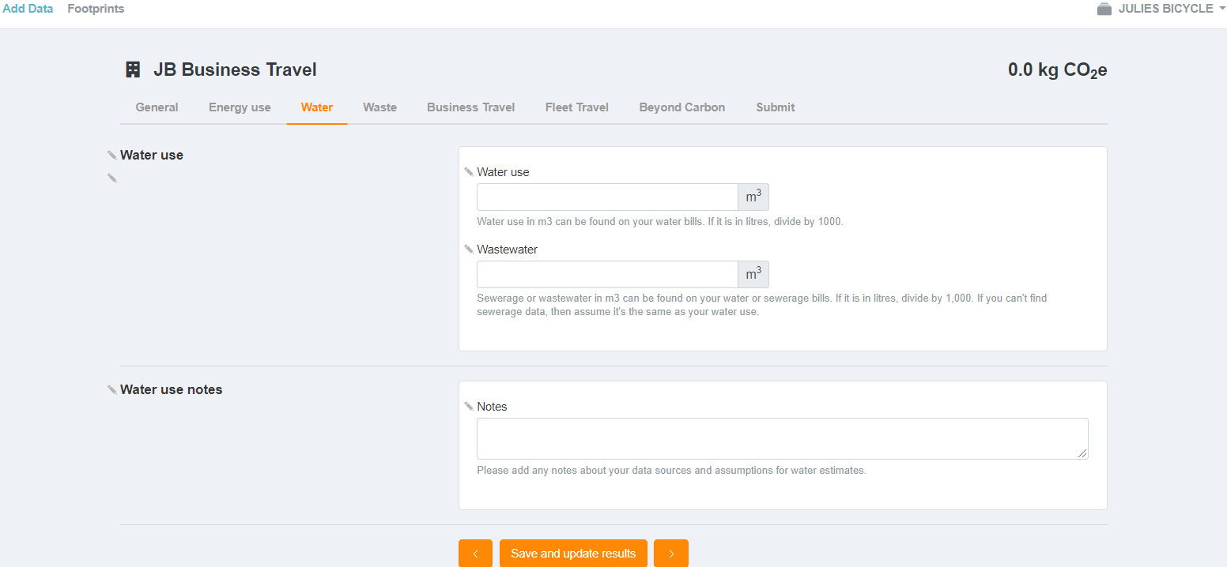
Footprints Page: Water
Water use and wastewater m3 can be found in your water bills

Slide 41
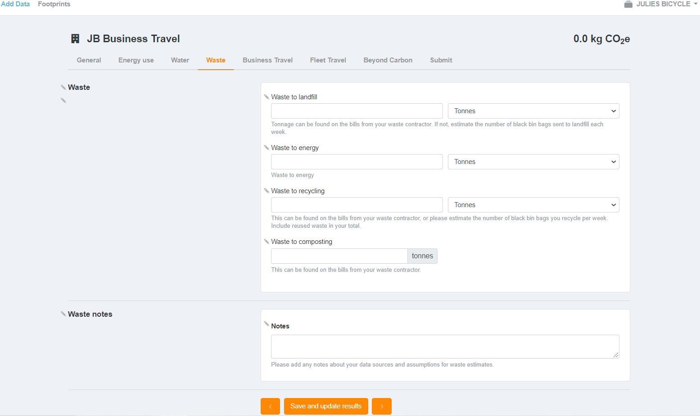
Footprints Page: Waste
Enter accurate or estimated waste figures

Slide 42
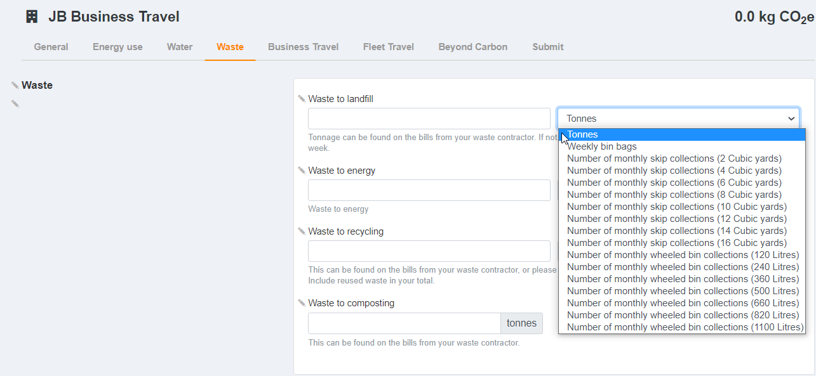
Footprints Page: Waste
Notes:
Select the most useful units to measure your waste data. If you use a specific company, see if they record your data and if so what unit of measure do they use?

Slide 43
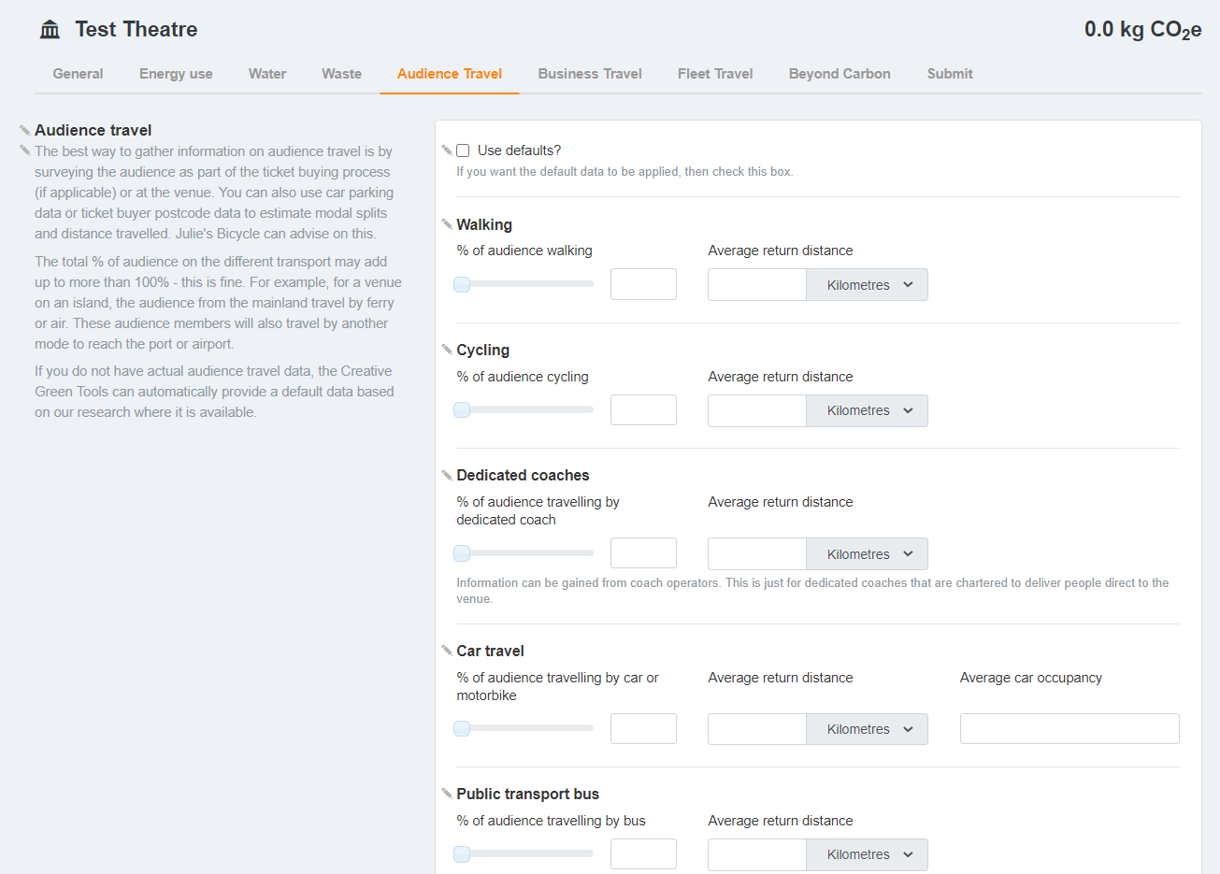
Footprints Page: Audience Travel
‘Venue/ Cultural Buildings’ have the option to enter audience Travel and ‘Projects’ that are events
Notes:
Audience travel data is collected via surveys – method of travel, i.e 70% people responded. Use default if you entered visitor numbers, it’ll generate a number.

Slide 44
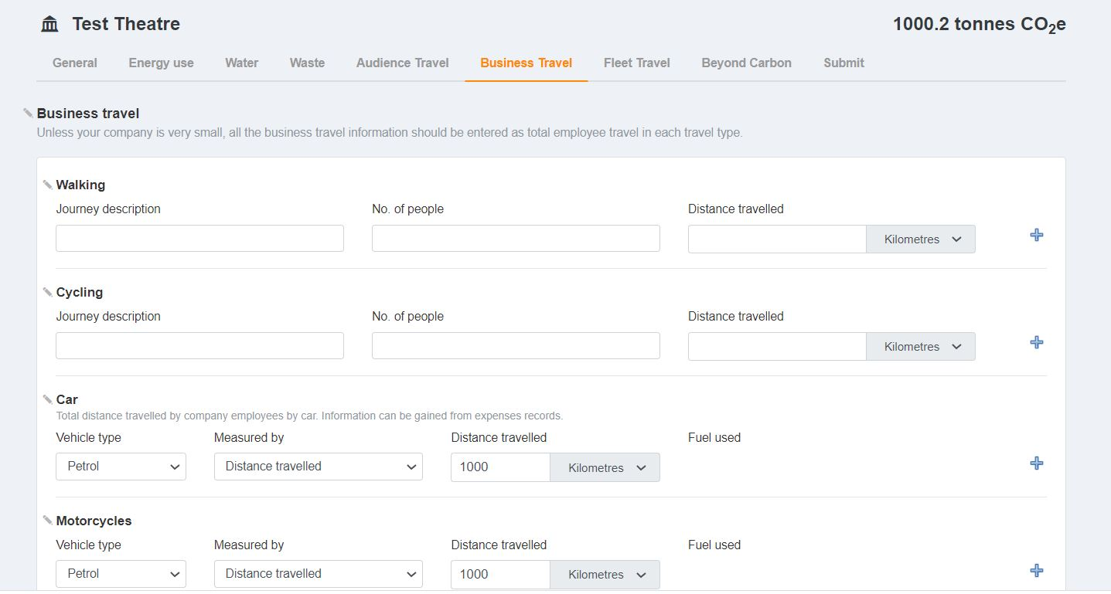
Footprints Page: Business Travel

Slide 45
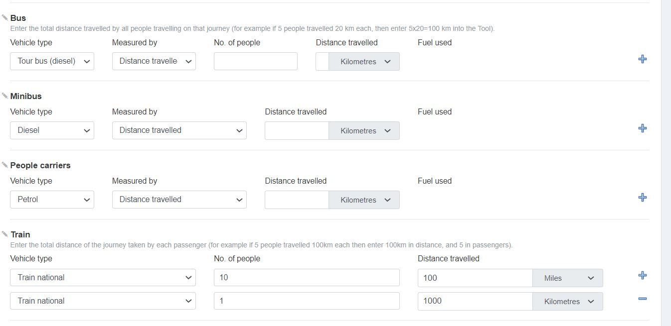
Footprints Page: Business Travel

Slide 46
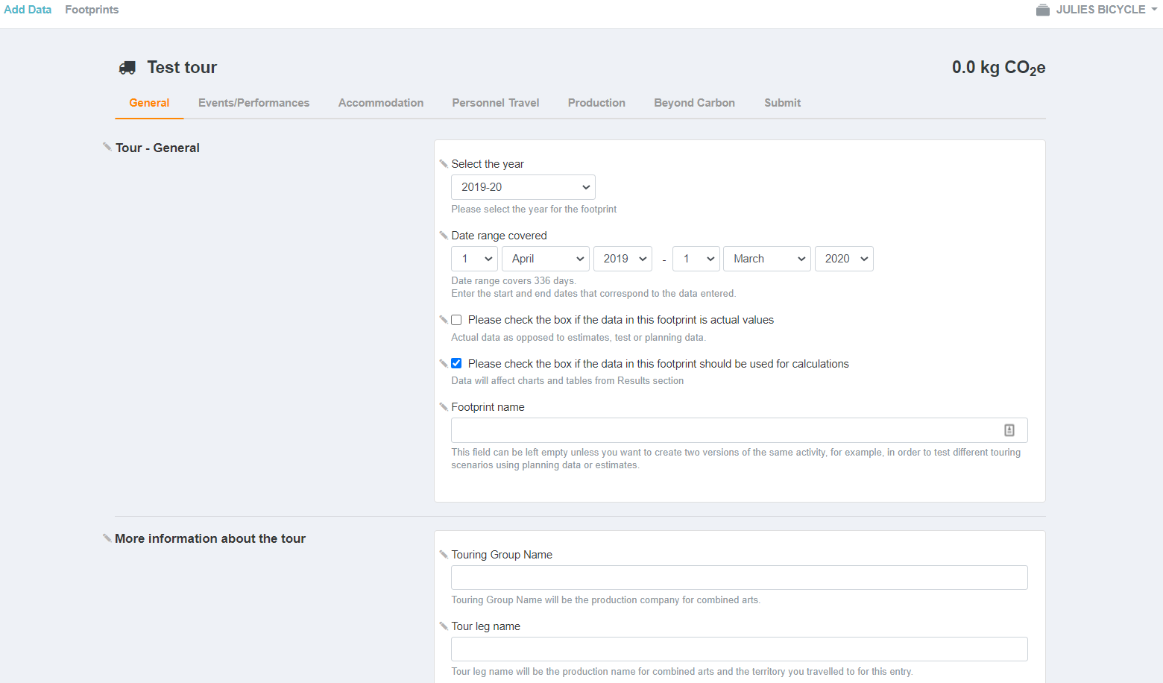
Footprint Page: Tour

Slide 47
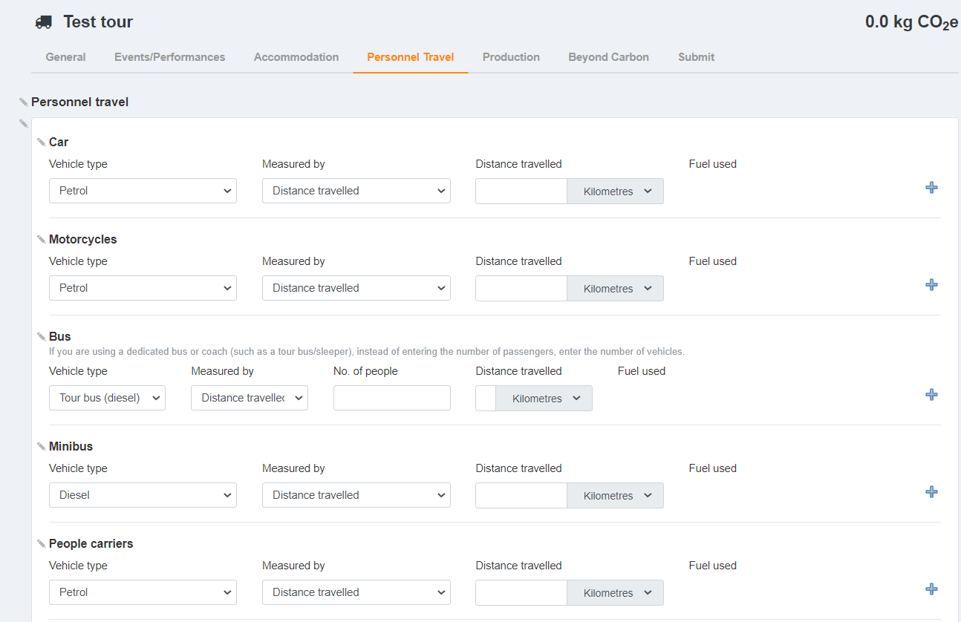
Footprint Page: Tour
Notes:
Personnel travel is … under projects: tour,

Slide 48
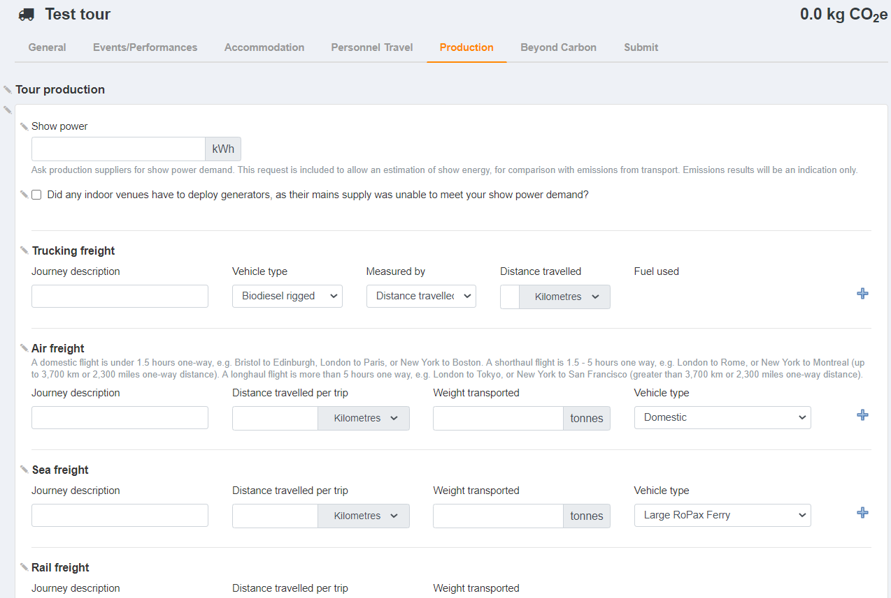
Footprint Page: Tour
Notes:
Production info found under: Projects: tour,

Slide 49
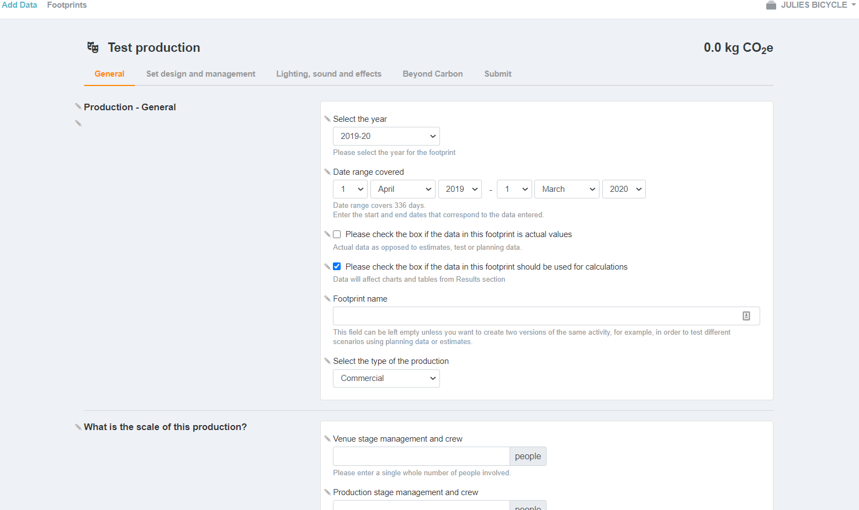
Footprint Page: Production

Slide 50
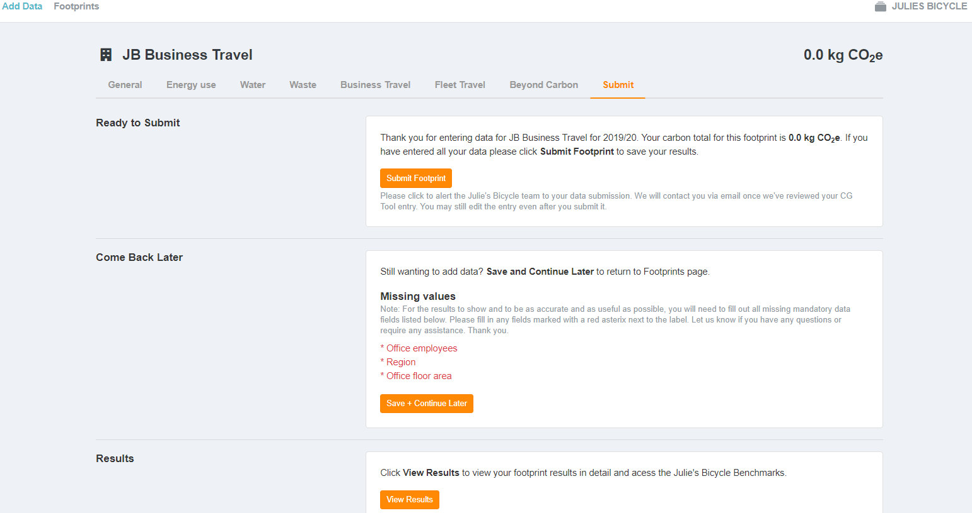
Footprint Page: Submit

Slide 51
Footprint Page: Submit
Notes:
It will tell you what critical information is missing before you submit.

Slide 52
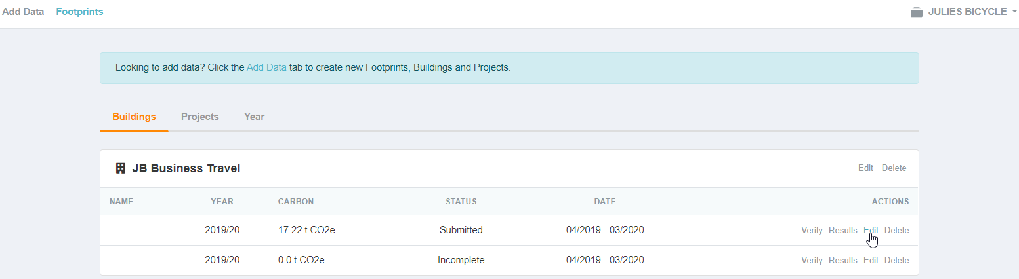
+ Data Page
Edit

Slide 53
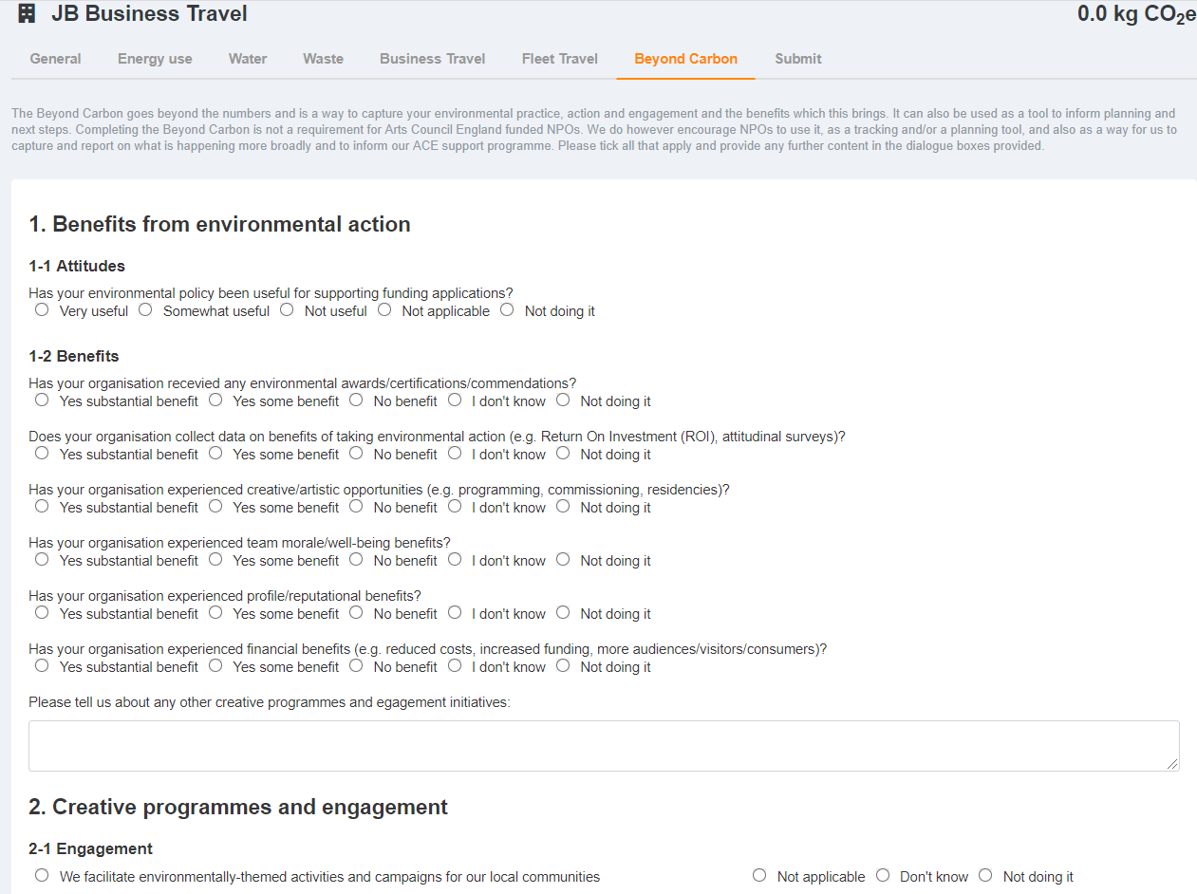
Beyond Carbon Page
1. Benefits from environmental action
2. Creative programmes and engagement
3. Governance and leadership
4. Everyday good practice
Notes:
Opportunity to provide qualitative information and indepth understanding of your work outside numeric observation

Slide 54
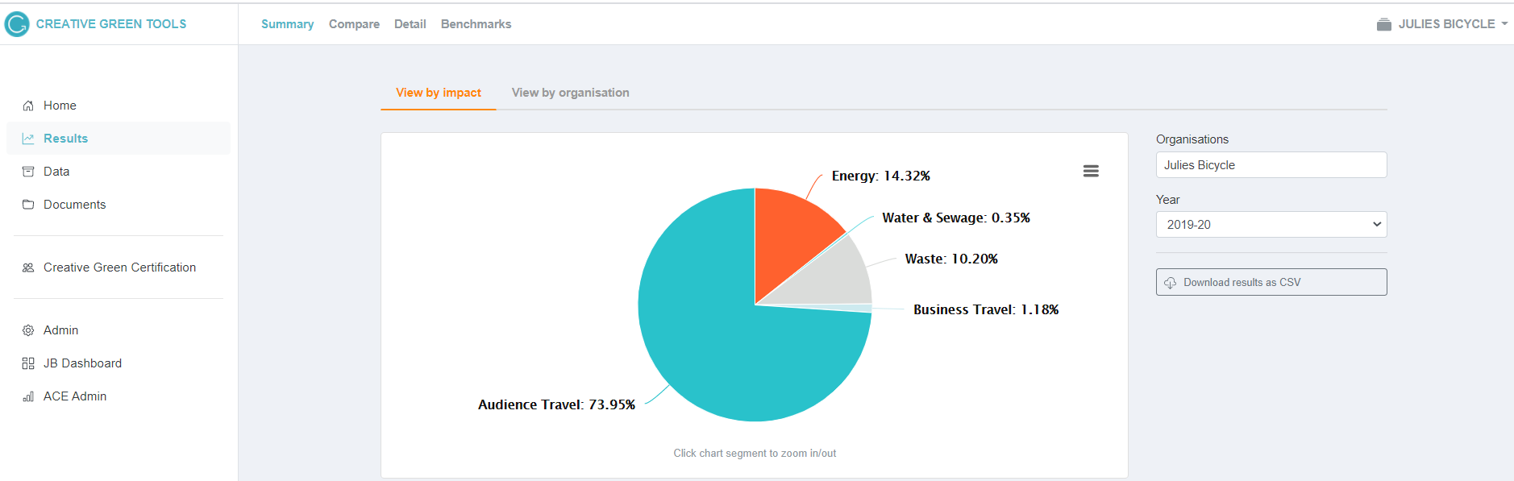
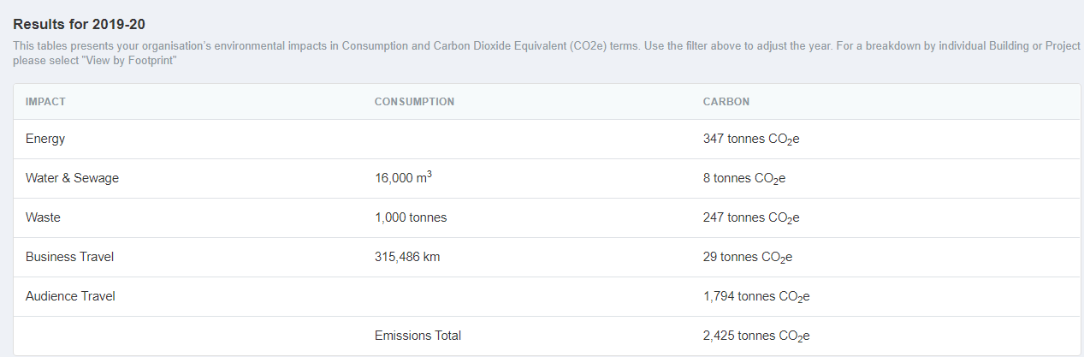
Results Page
v
Notes:
Download results as csv or png.

Slide 55





Slide 56


Results Page

Slide 57


Results Page

Slide 58
Things to remember
Organisations are encouraged to report where possible by the 30th October.
Your data should refer to the period: April 2019 – March 2020
“Submit your results” when you have completed your data entry
Uploaded your policy and action plan to the “Documents” page of the Creative Green Tools

Slide 59
Julie’s Bicycle support and resources
Creative Green Tools: www.ig-tools.com
Environmental Policy and Action Plan guidelines: http://www.juliesbicycle.com/resources/environmental-policy-and-action-plan-guidelines
Other relevant resources: http://www.juliesbicycle.com/resources + Guide to reporting and touring
For queries, please e-mail or phone us:
E-mail: support@juliesbicycle.com
Phone: 07379 245997 – available Tuesday – Thursday

Slide 60


Q&A
Julie’s Bicycle
Somerset House, London
0208 746 0400
support@juliesbicycle.com | www.juliesbicycle.com

